Slide 1
2022 AML-1214 Real-time Face MASK DETECTION
Muhammad Ghous C0846228
Clannon Noronha C0846110
Harshkumar Patel C0848343
Darshakkumar Ranpariya C0849251

Slide 2
Agenda
Introduction
Dataset
Model
Result
Working

Slide 3
Introduction
Implementation of System to Detect Face Mask
Detecting Using Real-Time and Video Feed from the system
Based on the Yolo5 Object Detection Algorithm
YOLO: You Only Look Once
Able to detect a person wearing a mask or not and also improper wearing

Slide 4
Dataset

Slide 5
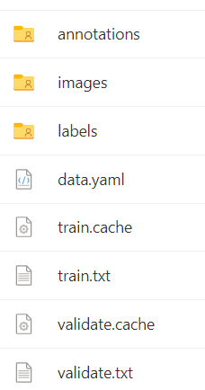
Dataset Labeling
Collected dataset with 853 images with XML annotations
Converted XML annotation to YOLOv5 labelling format
Labelled each image so that our algorithm can learn if a person is wearing a mask or not.
annotations folder contains XML files with bounding boxes
Images folder contains all images
Labels folder contains YOLOv5 label format text files

Slide 6
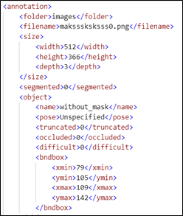
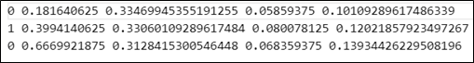
The XML annotation file contains the properties and bounding boxes of an image.
Converting XML file to YOLOv5 labelling format text file which is looks like (Figure 2)
Here,
Class 0: for No mask Label
Class 1: For Mask Label
Class 2: Improper Mask Label
Format: class x_center y_center width height

Slide 7
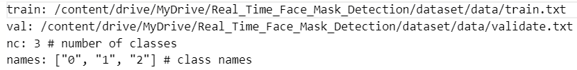
Splitting Dataset
Split dataset into train and validation sets 90% and 10% respectively.
Training images path stored in the train.txt and validation images path stored in validate.txt
Trained model with these images with the help of google colab GPU for faster performance.

Slide 8
Model

Slide 9
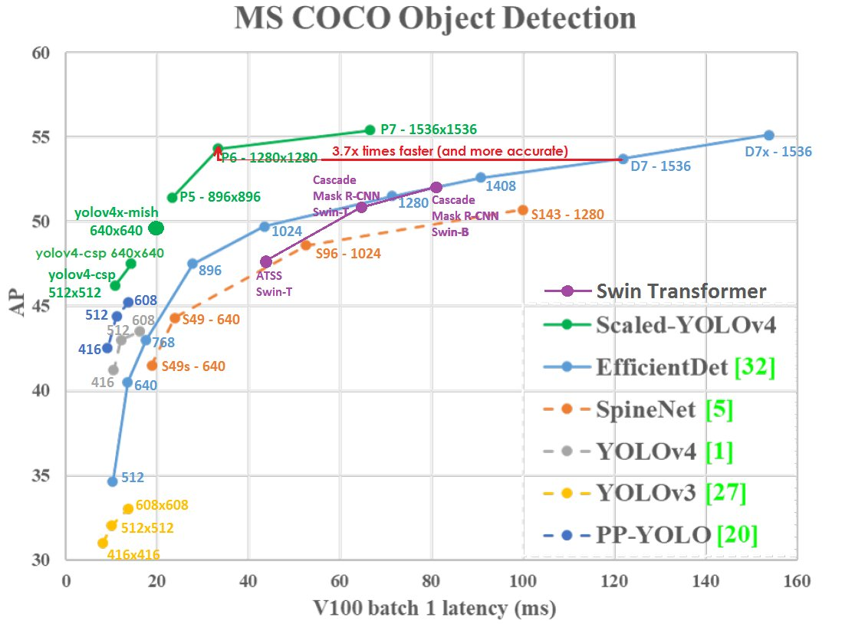
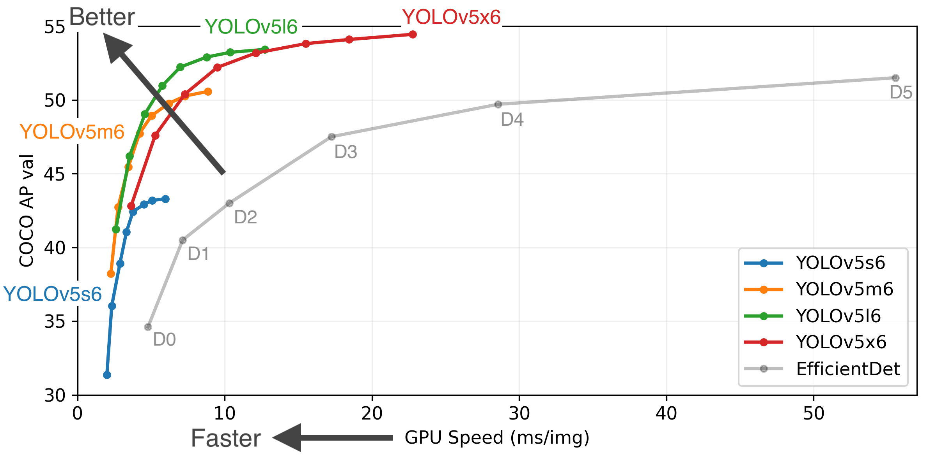
YOLOv5

Slide 10
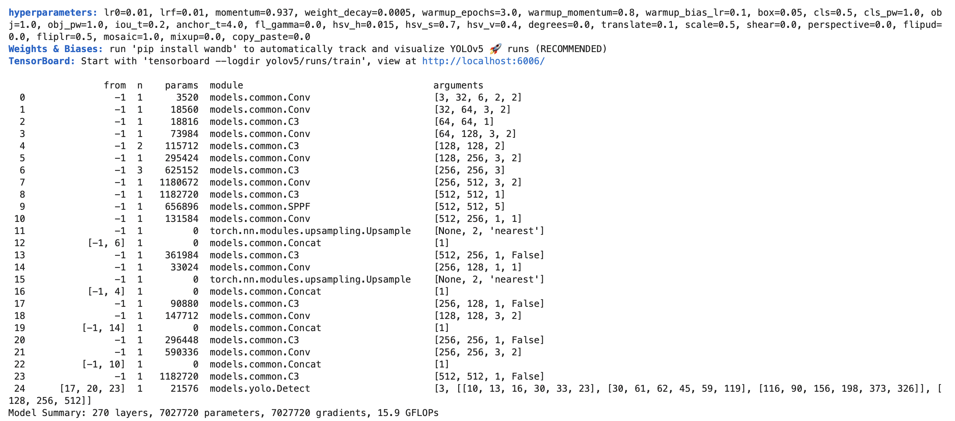
Model Summary

Slide 11
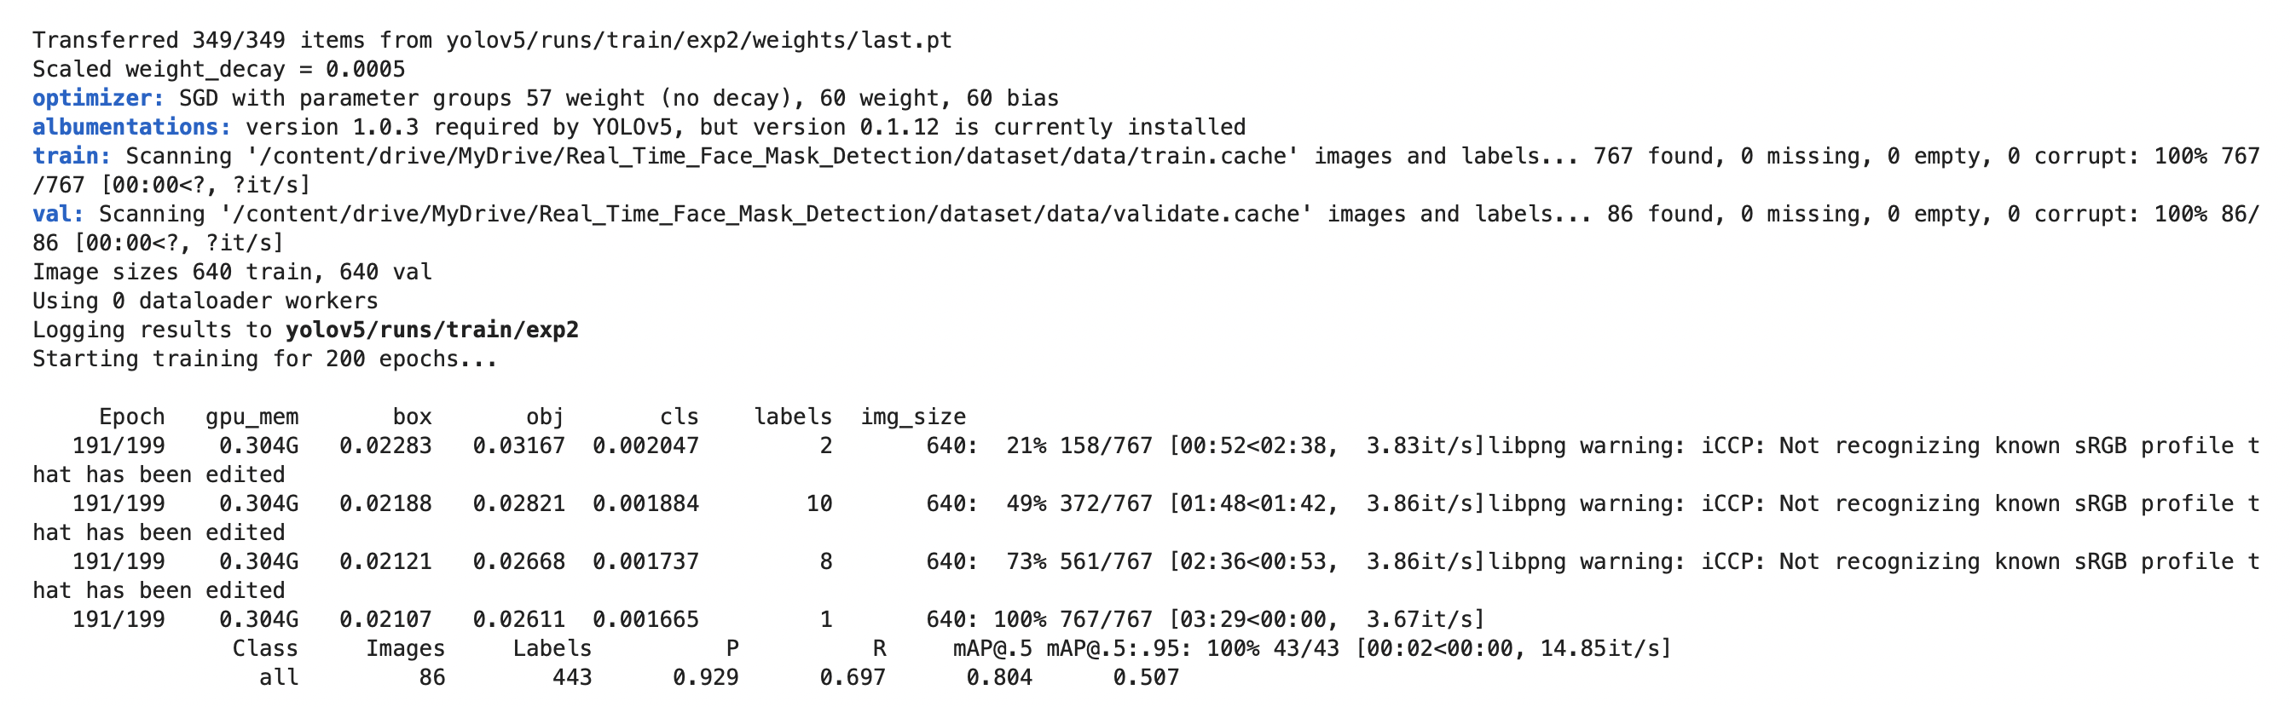

Slide 12
result

Slide 13
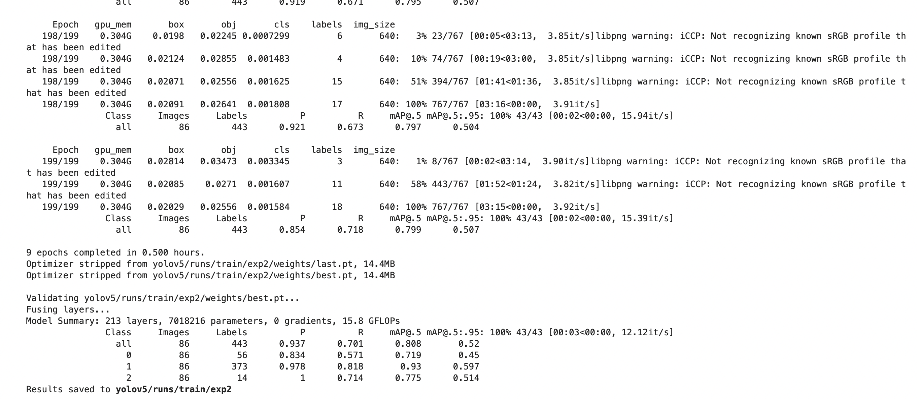
Performance
Performed 200 epoch
The training speed is 12.12 it/s
Achieved accuracy by 0.808 mAP
Final and best model stored in best.pt

Slide 14
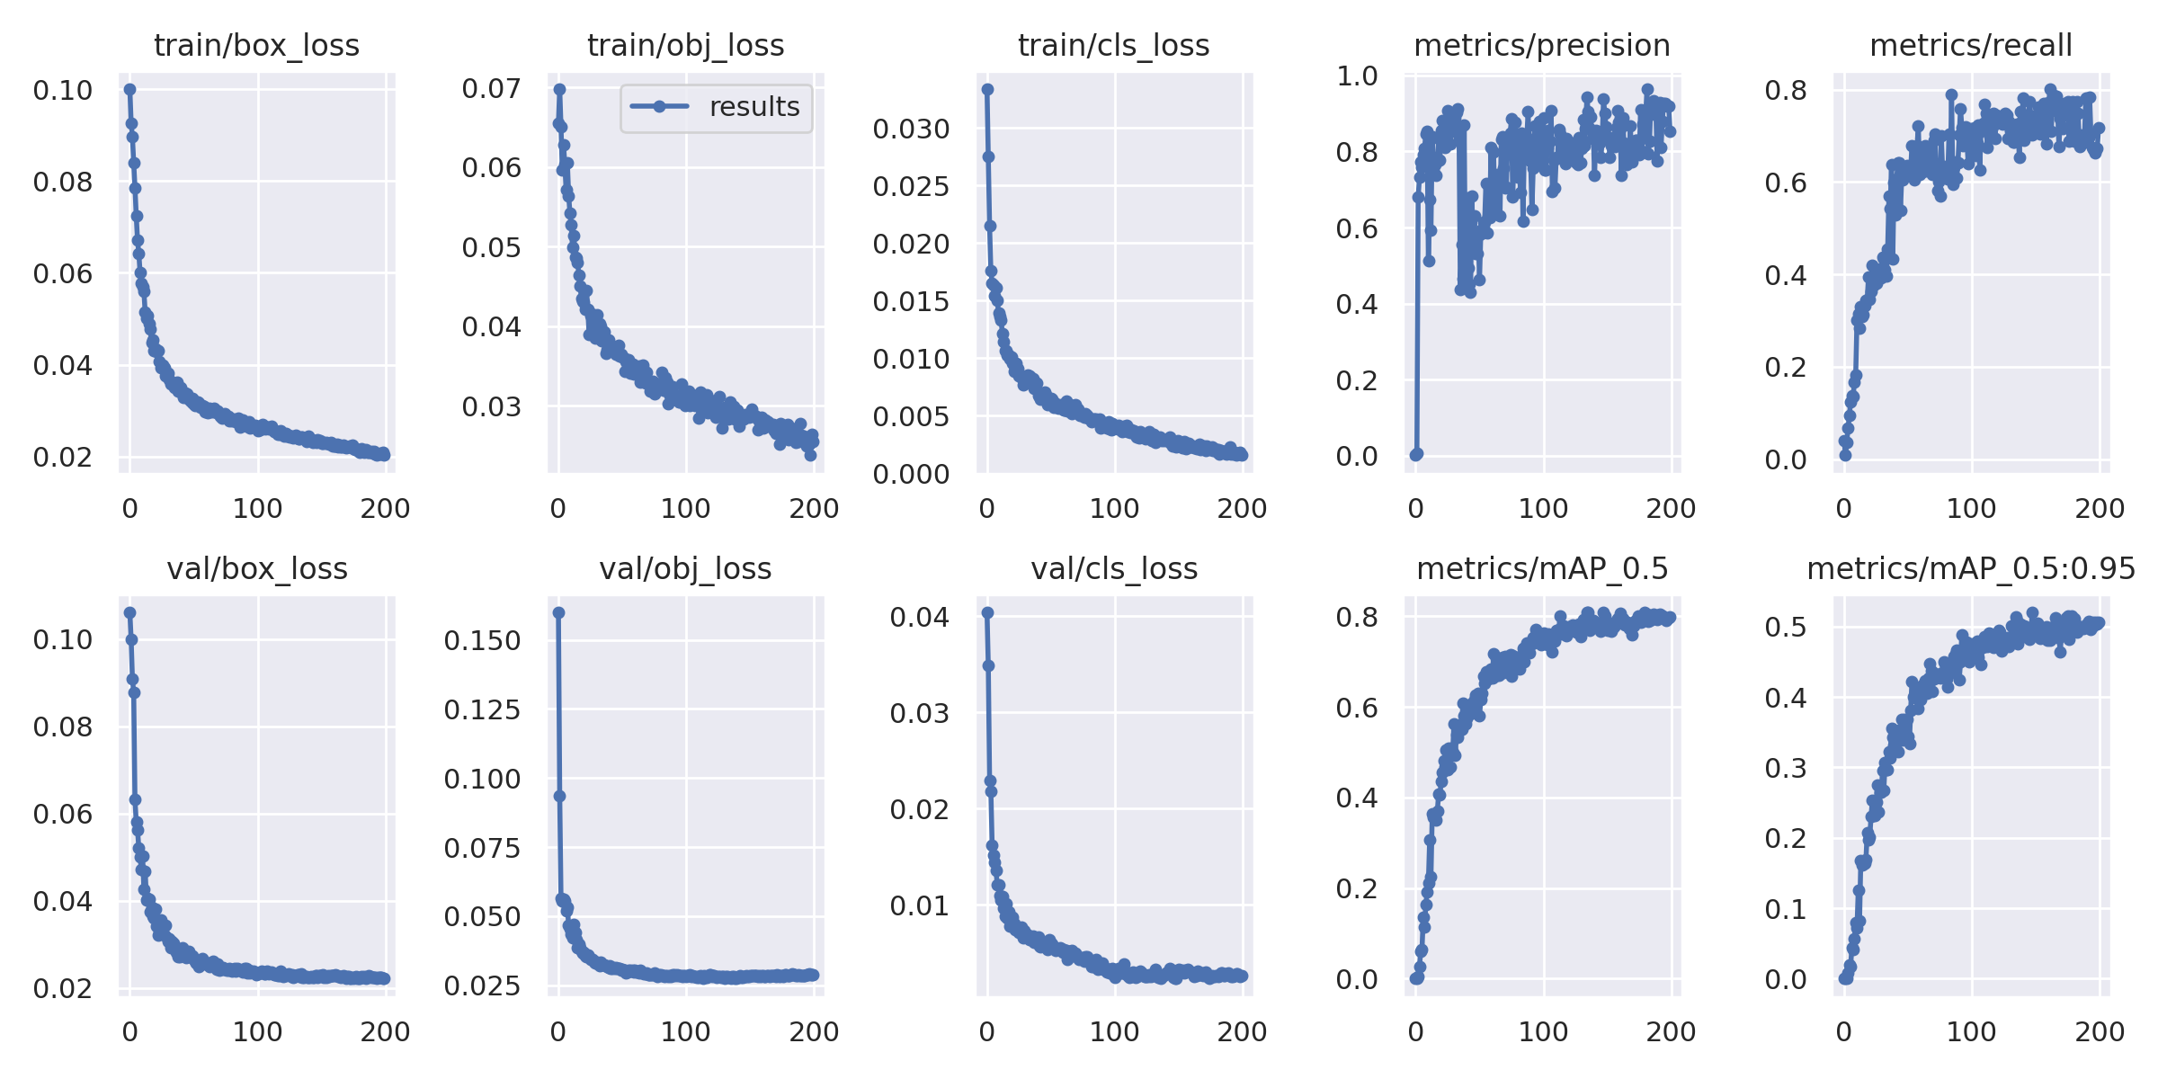
Performance Graph

Slide 15
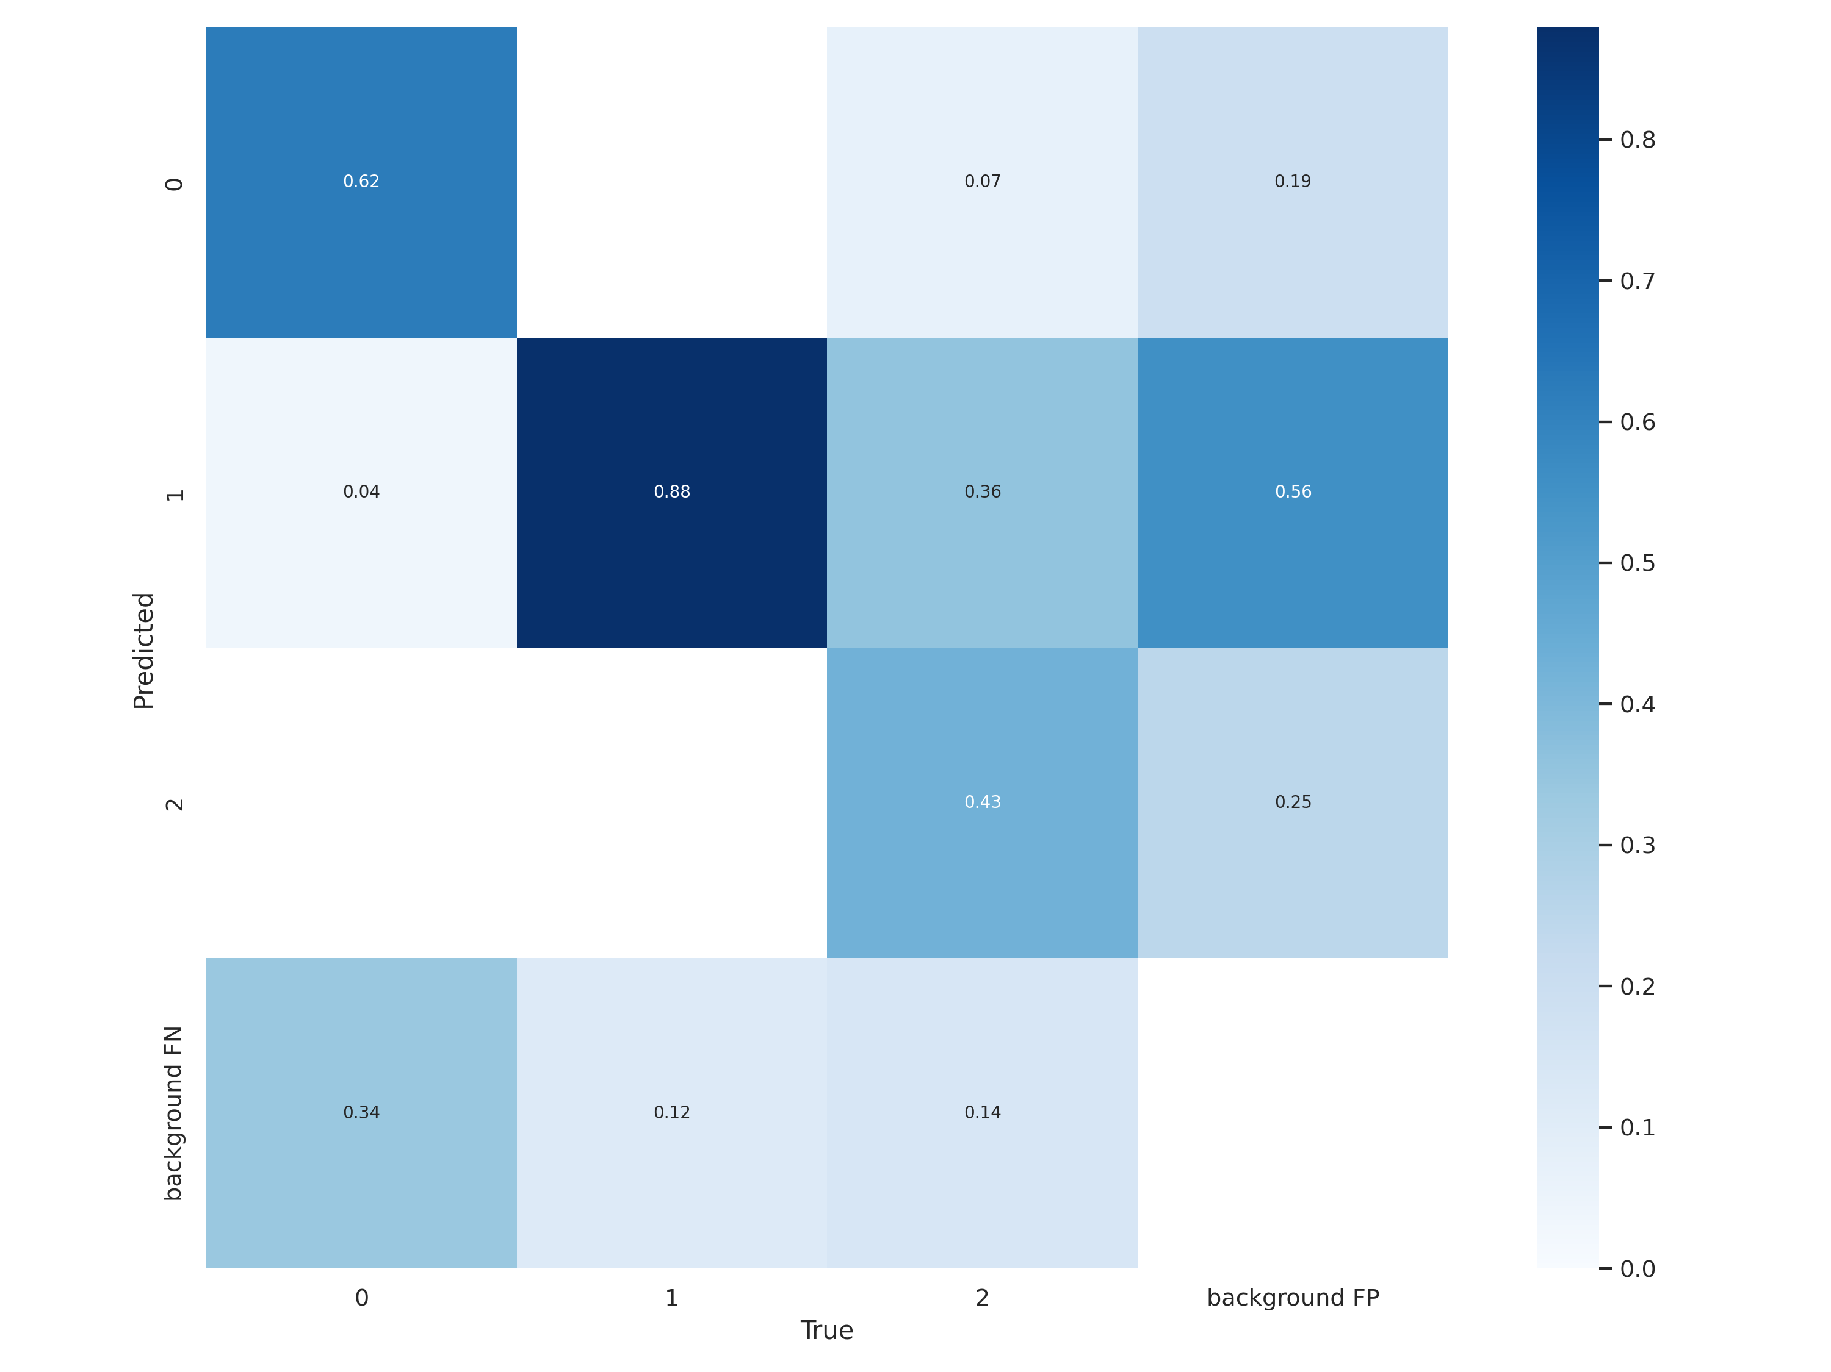
Confusion Matrix

Slide 16
working

Slide 17

User Login

Slide 18
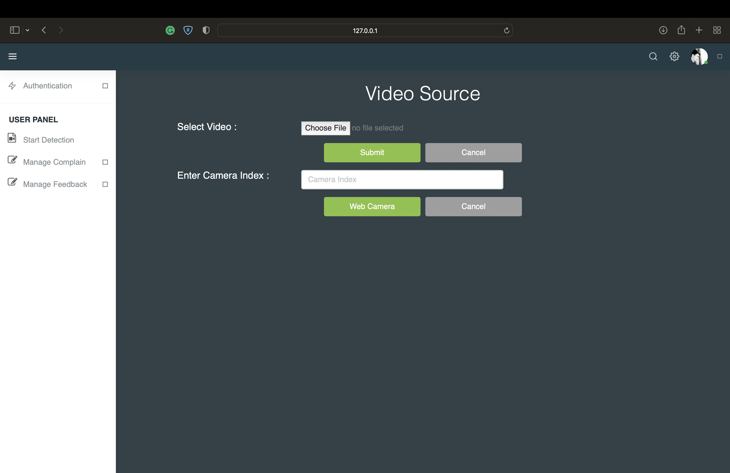
Video Source

Slide 19
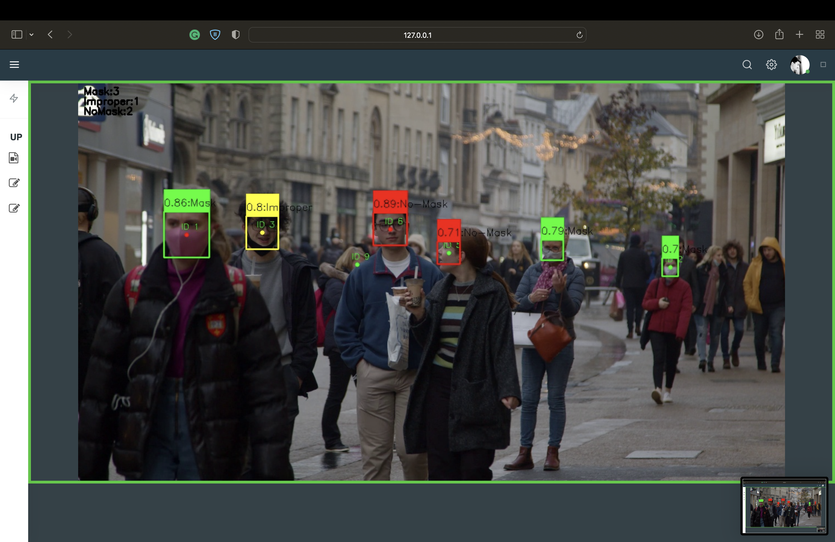
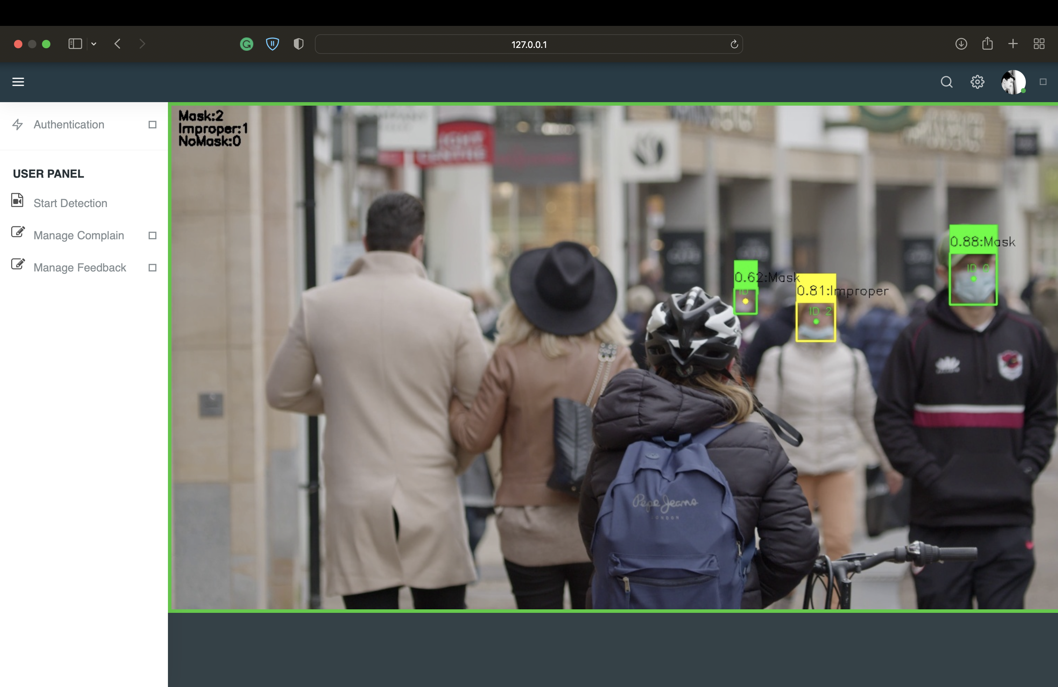
Video Feed

Slide 20
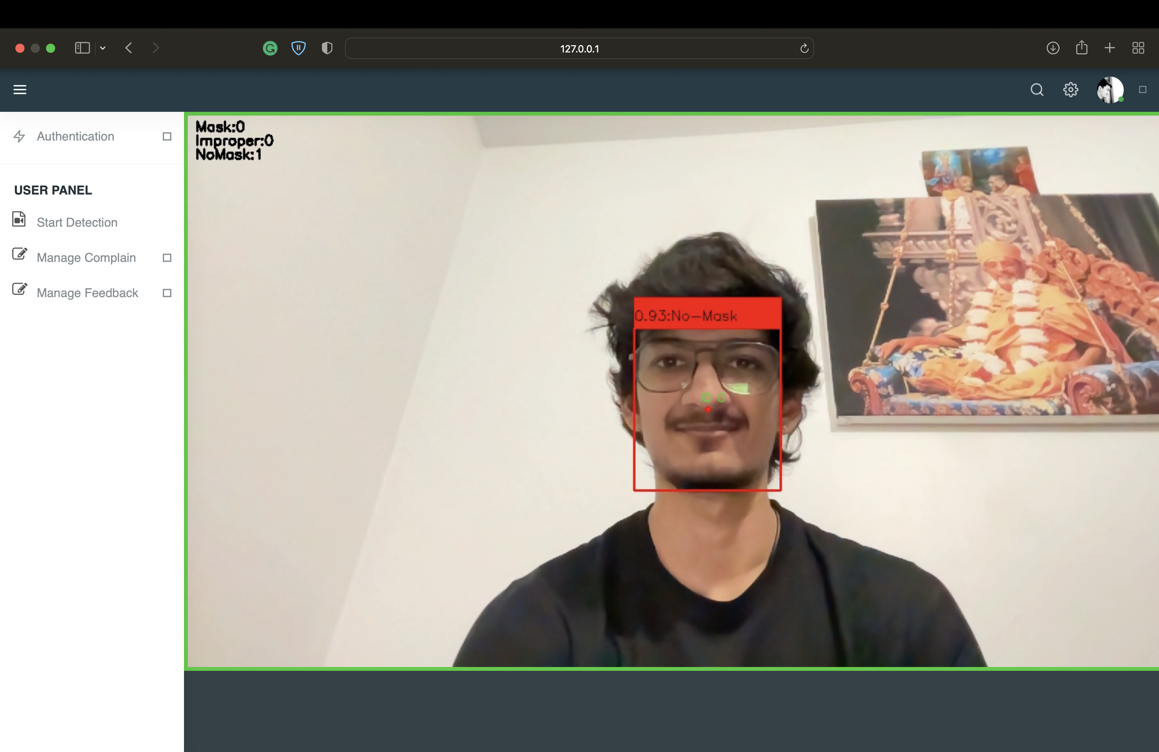
No-Mask

Slide 21
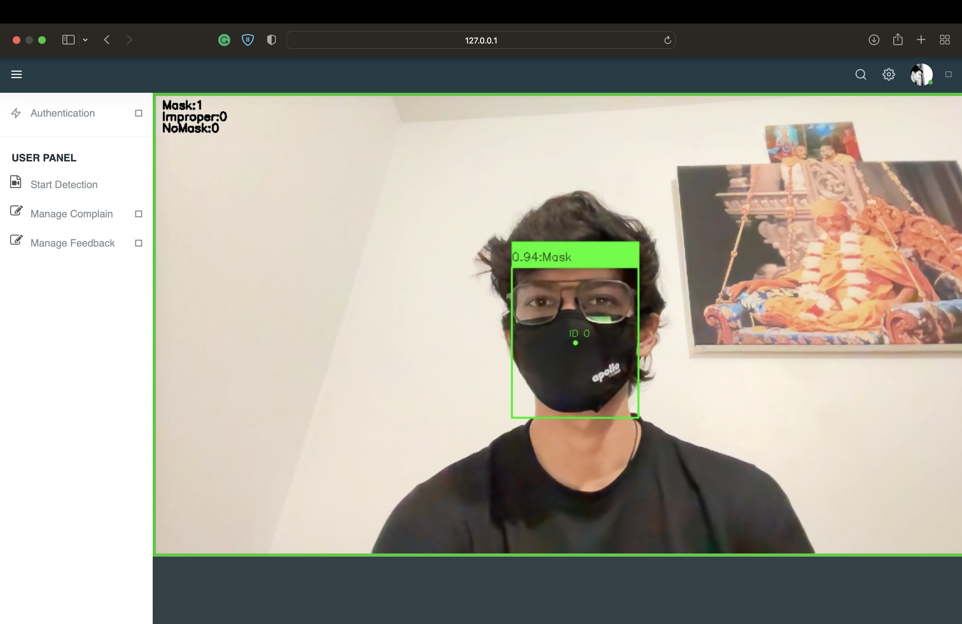
Mask

Slide 22
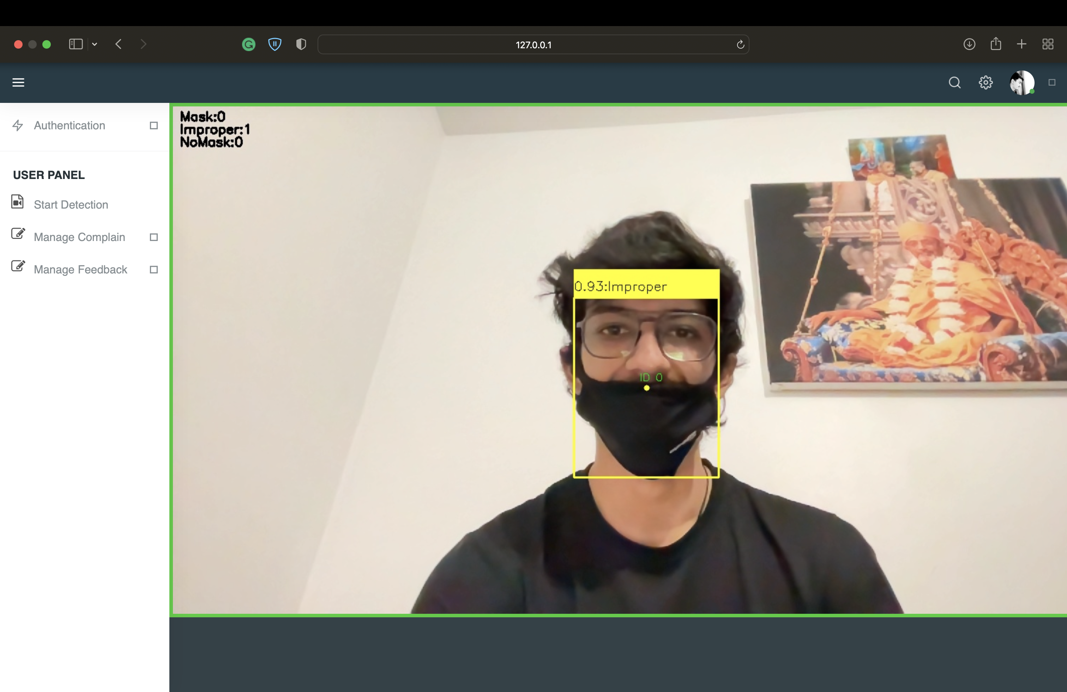
Improper Mask

Slide 23
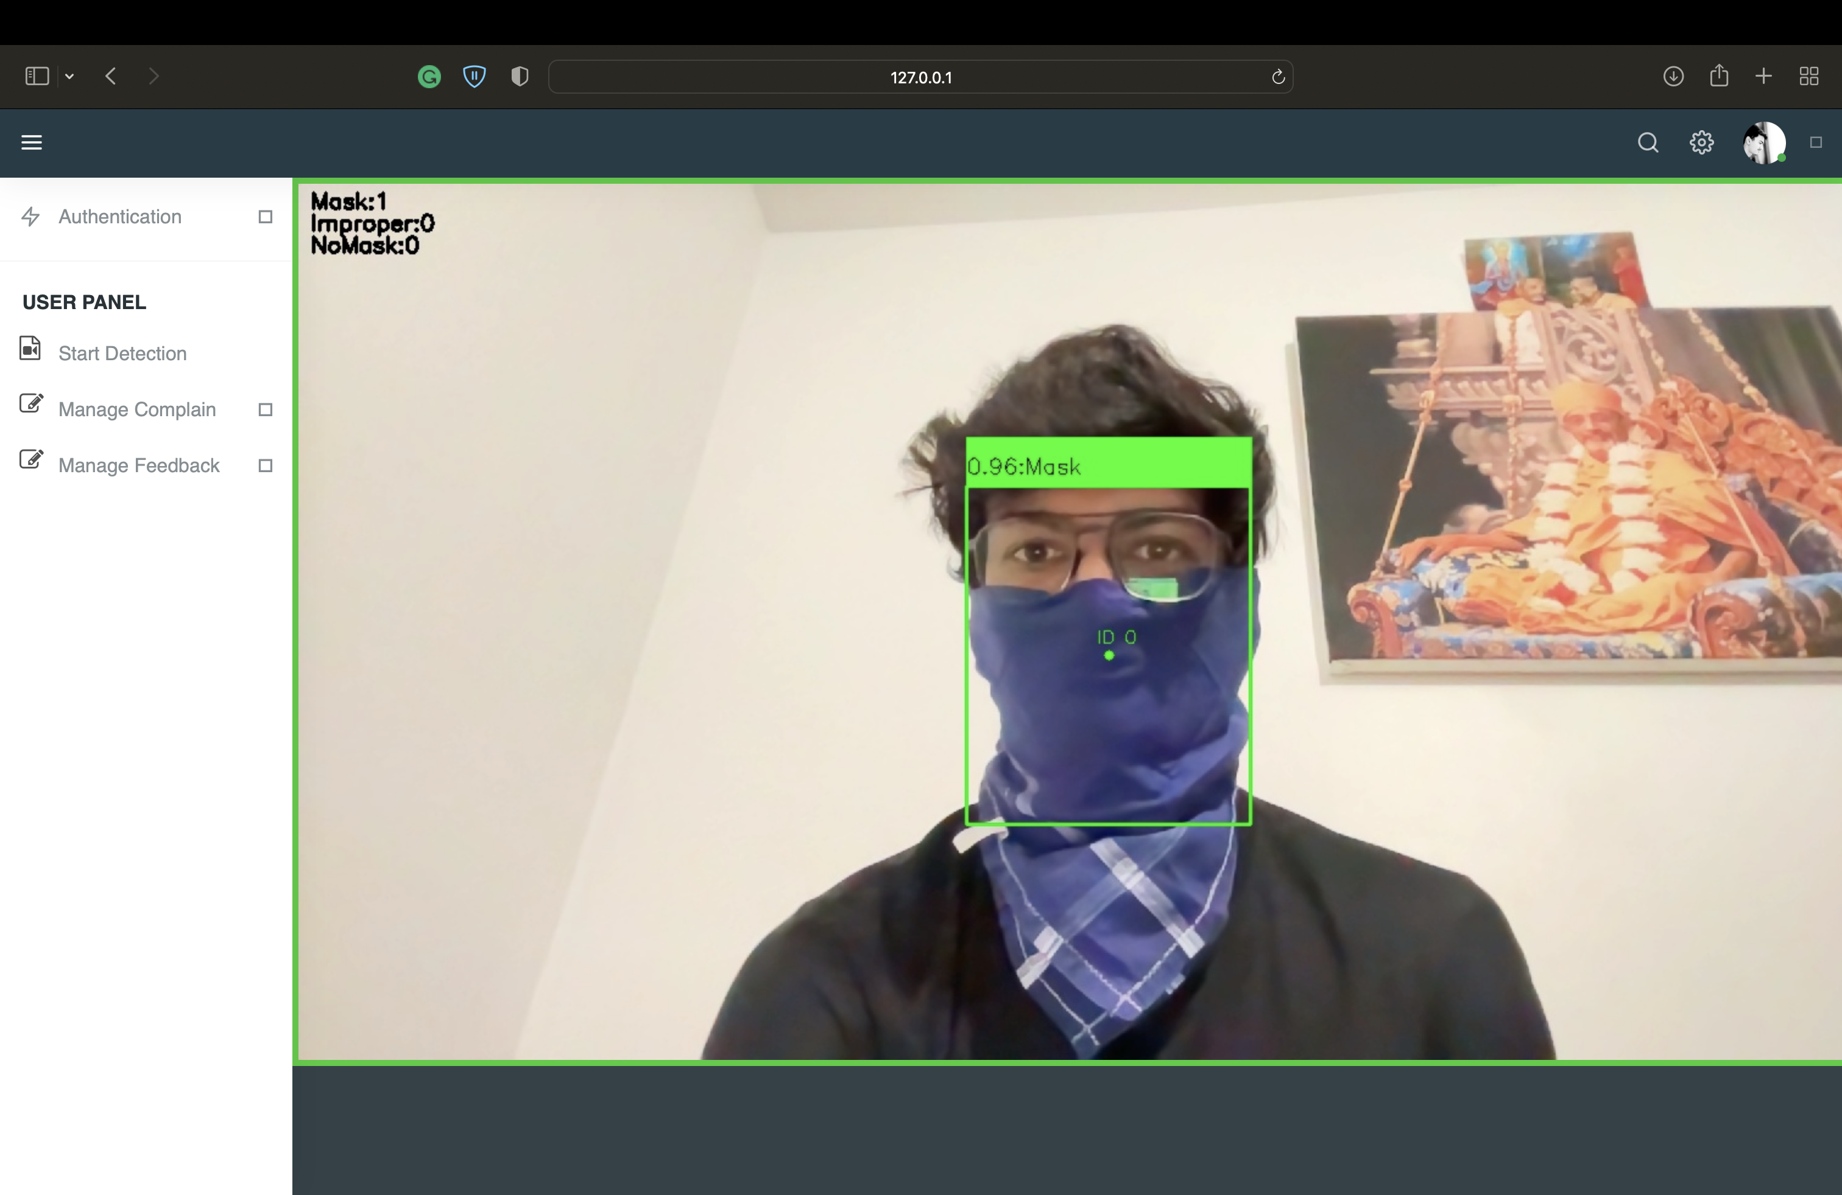
Piece of Cloth as Mask

Slide 24
Thank you 🙂

